Slide 1
Unit 3
Data Link Layer

Slide 2
Syllabus
Unit-3: Data Link Layer Error Detection and Correction: Types of Errors, Detection, Error Correction.
Data Link Control and Protocols: Flow and Error Control, Stop-and-wait ARQ, Go-Back-N ARQ, Selective Repeat ARQ, HDLC, PPP.
Multiple Accesses: Random Access, Controlled Access, Channelization. Local area Network: Standard Ethernet, Wireless LANs: IEEE 802.11.

Slide 3
Error Detection and Correction

Slide 4
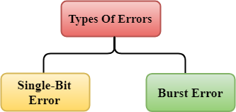
Error Detection
When data is transmitted from one device to another device, data can be corrupted during transmission.
An error is a situation when the message received at the receiver end is not identical to the message transmitted.

Slide 5
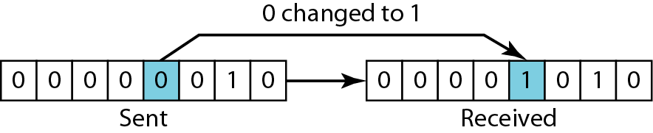
Single-Bit Error
The term single-bit error means that only 1 bit of a given data unit is changed from 1 to 0 or from 0 to 1.

Slide 6
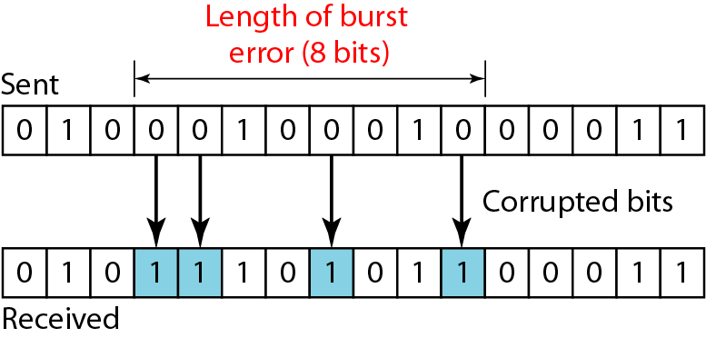
Burst Error
A burst error means that 2 or more bits in the data unit have changed.
Fig : Burst error of length 8

Slide 7
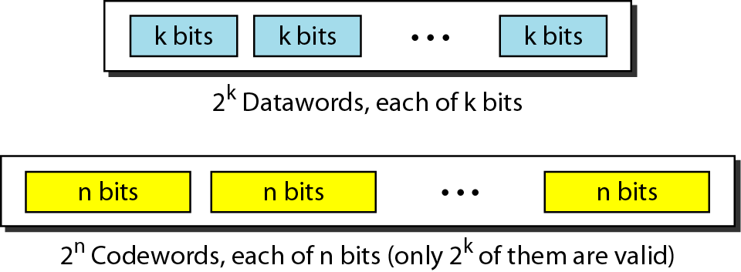
Block Coding
In block coding, we divide our message into blocks, each of k bits, called datawords. We add r redundant bits to each block to make the length n = k + r. The resulting n-bit blocks are called codewords.
Fig: Datawords and codewords in block coding

Slide 8
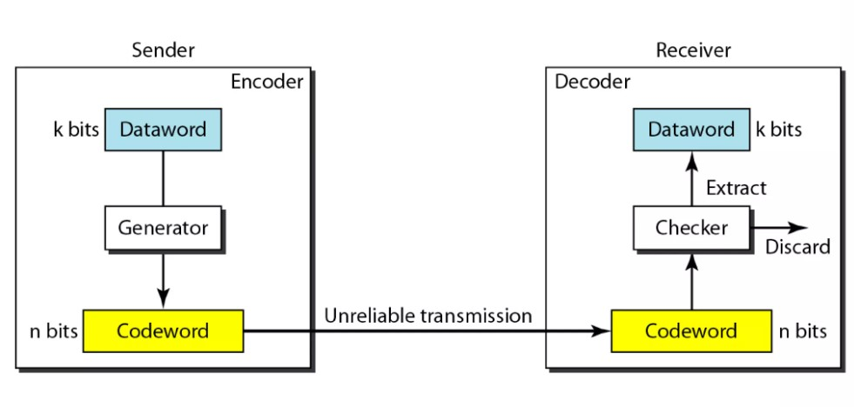
Process of error detection in block coding

Slide 9
Block Coding
Let us assume that k=2 and n=3. Table 1 shows the list of data words and codewords.
Table 1: A code for error detection

Slide 10
Valid & Invalid Code Word
Assume the sender encodes the dataword 01 as 011 and sends it to the receiver. Consider the following cases. Consider the following cases.
The receiver receives 011. It is a valid codeword. The receiver extracts the data word 01 from it.
The codeword is corrupted during transmission and 111 is received. This is not a valid codeword and is discarded.
The codeword is corrupted during transmission and 000 is received (the right two bits are corrupted). This is a valid codeword. The receiver incorrectly extracts the datawords 00. Two corrupted bits have made the error undetectable.

Slide 11
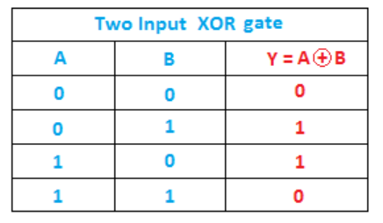
Hamming Distance
The Hamming distance between two words is the number of differences between corresponding bits.
Hamming distance between two pairs of words.
1. The Hamming distance d(000,011) is 2
2. The Hamming distance d(10101, 11110) is 3

Slide 12
Minimum Hamming Distance
The minimum Hamming distance is the smallest Hamming distance between all possible pairs in a set of words.
Find the minimum Hamming distance of the coding
Solution
We first find all Hamming distances.
The d_{min} in this case is 2.

Slide 13
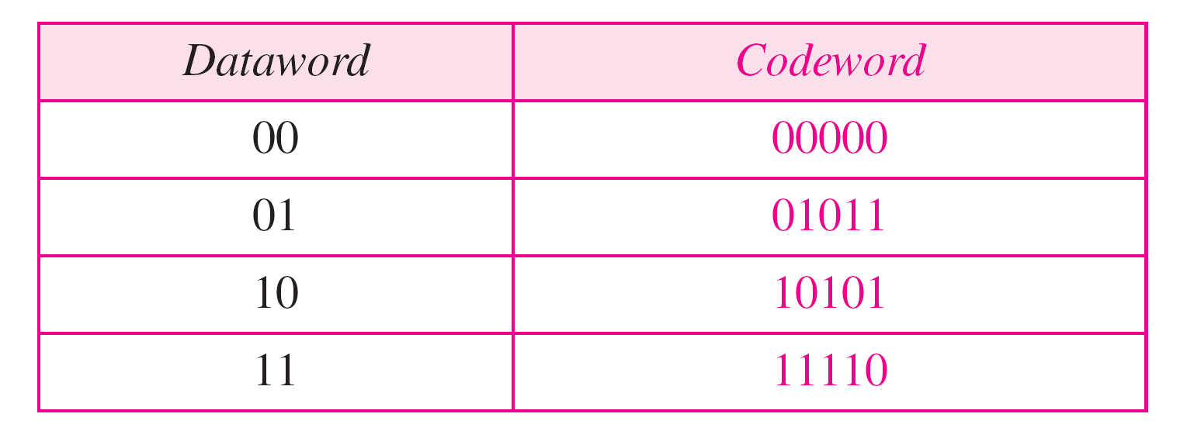
Find the minimum Hamming distance of the coding scheme

Slide 14
Find the minimum Hamming distance of the coding scheme
Solution
We first find all the Hamming distances.
The d_{min} in this case is 3.

Slide 15
LINEAR BLOCK CODES
A Linear Block Code is a type of block code in which every valid codeword is a linear combination of the message bits.
It maps k information bits into an n-bit codeword by adding (n−k) parity bits.
The modulo-2 sum (XOR) of any two valid codewords is also a valid codeword.
Examples of Linear Block Codes
Single Parity Check Code
Hamming Code
Cyclic Code
Reed–Solomon Code
BCH Code
Golay Code

Slide 16
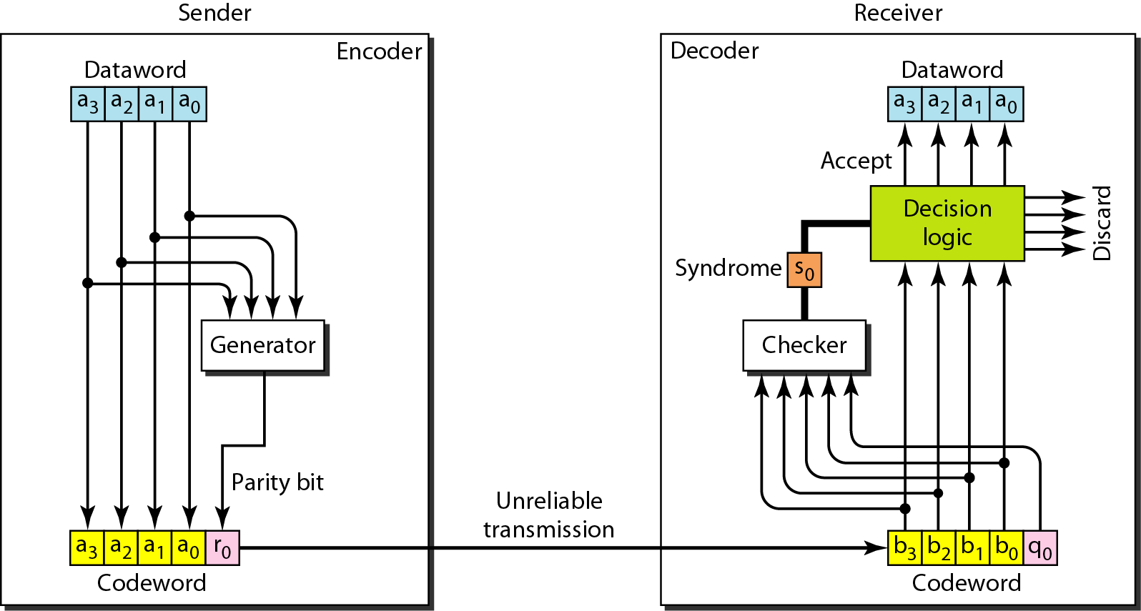
Single Parity Check Code
In this code, a r-bit dataword is changed to an n-bit codeword where n = k + 1.
The extra bit is called the parity bit, is selected to make the total number of 1’s in the codeword even (for even parity) or odd (for odd parity) .
If the number of 1’s is even, the result is 0;
if the number of 1s is odd, the result is 1.
In both cases, the total number of 1s in the codeword is even.

Slide 17

Hamming Code
Hamming code is a linear block code which adds parity bits to the original data bits to detect and correct transmission errors.
Hamming code can correct single-bit errors and detect double-bit errors (with an additional overall parity bit).
Number of Parity Bits
Placement of Data & Parity Bits
Place parity bits at positions: 1, 2, 4, 8, ... (powers of 2)
Insert data bits in the remaining positions.
Parameter | Description | Example: Hamming (7,4)
k | Data bits | 4
r | Parity/redundant bits | 3
n | Total codeword bits | 7
(n,k) | Code notation | (7,4)

Slide 18
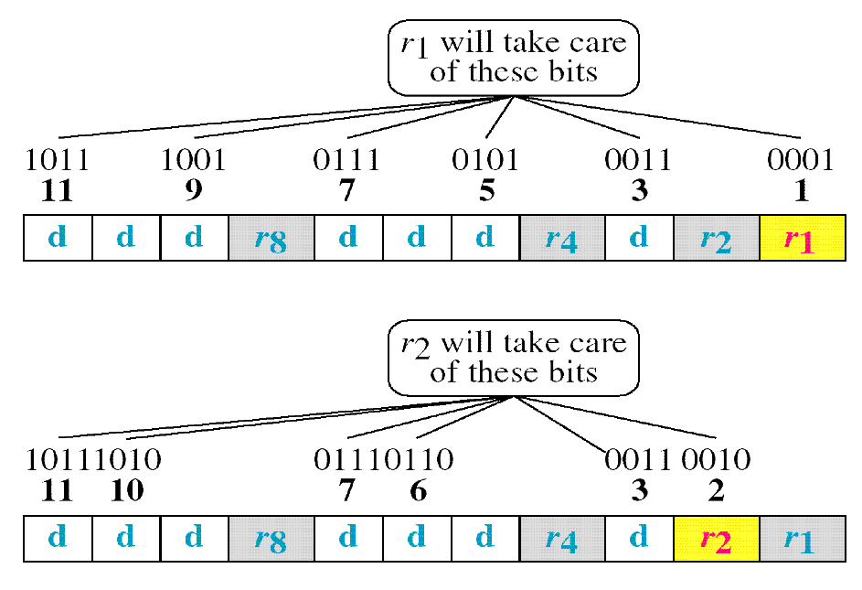
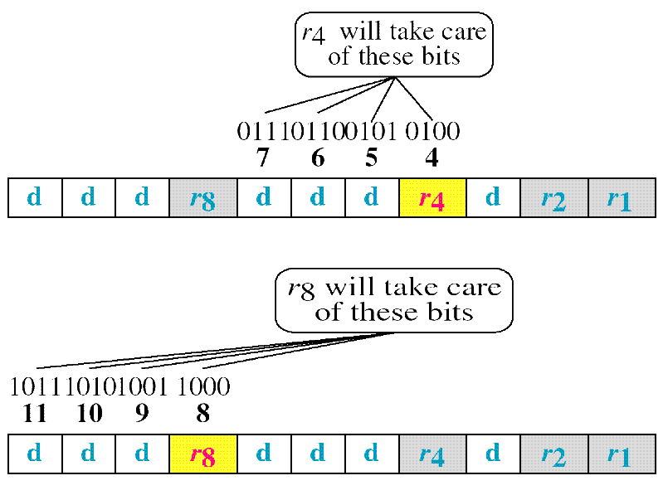
Hamming Code
P1: checks 1 bit, then skips 1 bit, and repeats this pattern until the end of the codeword.
P2: checks 2 consecutive bits, then skips 2 bits, and repeats this pattern throughout the codeword.
P4: checks 4 consecutive bits, then skips 4 bits, and continues this alternating pattern until the last bit.
P8: checks 8 consecutive bits, then skips 8 bits, and repeats this process across the entire codeword.

Slide 19
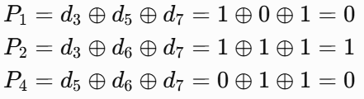
A 4-bit data block D=[1 1 0 1] is to be transmitted using the Hamming (7,4) code with even parity.
(i) Construct the corresponding 7-bit Hamming codeword by determining the parity bits P1​, P2​, and P4​.
(ii) Assume that during transmission, the 4th bit of the codeword is corrupted. Determine the received codeword and use syndrome decoding to detect and locate the error.
(iii) Correct the erroneous bit and recover the original 4-bit data block.
(i) Construct the corresponding 7-bit Hamming codeword by determining the parity bits P1​, P2​, and P4
Bit Position | 7 | 6 | 5 | 4 | 3 | 2 | 1
Bit Type | d₇ | d₆ | d₅ | P₄ | d₃ | P₂ | P₁
Data Word (without parity) | 1 | 1 | 0 |  | 1
P₁ = d₃ ⊕ d₅ ⊕ d₇ | 1 |  | 0 |  | 1 |  | 0
P₂ = d₃ ⊕ d₆ ⊕ d₇ | 1 | 1 |  |  | 1 | 1
P₄ = d₅ ⊕ d₆ ⊕ d₇ | 1 | 1 | 0 | 0
Final Codeword | 1 | 1 | 0 | 0 | 1 | 1 | 0
Final Code Word: 1100110

Slide 20

(ii) Assume that during transmission, the 4th bit of the codeword is corrupted. Determine the received codeword and use syndrome decoding to detect and locate the error.
Original: 1100110
Bit 4 changes from 0 → 1
Codeword: 1101110​
Bit Position | 7 | 6 | 5 | 4 | 3 | 2 | 1 | Parity Check (XOR) | Syndrome
Bit Type | d₇ | d₆ | d₅ | P₄ | d₃ | P₂ | P₁
Received Codeword | 1 | 1 | 0 | 1 | 1 | 1 | 0
S₁ (Checks 1,3,5,7) | 1 |  | 0 |  | 1 |  | 0 | 0 ⊕ 1 ⊕ 0 ⊕ 1 = 0 | S₁ = 0
S₂ (Checks 2,3,6,7) | 1 | 1 |  |  | 1 | 1 |  | 1 ⊕ 1 ⊕ 1 ⊕ 1 = 0 | S₂ = 0
S₄ (Checks 4,5,6,7) | 1 | 1 | 0 | 1 |  |  |  | 1 ⊕ 0 ⊕ 1 ⊕ 1 = 1 | S₄ = 1
Hence, the error is at bit position 4.
(iii) Correct the erroneous bit and recover the original 4-bit data block.
Bit Position | 7 | 6 | 5 | 4 | 3 | 2 | 1
Received | 1 | 1 | 0 | 1 | 1 | 1 | 0
Corrected | 1 | 1 | 0 | 0 | 1 | 1 | 0

Slide 21
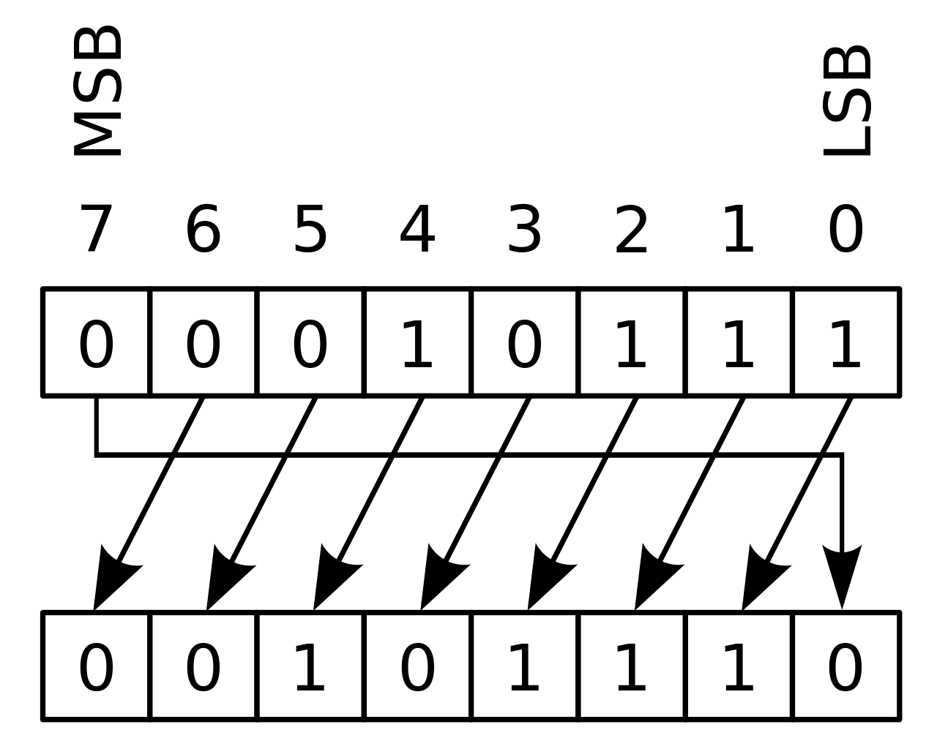
Cyclic Codes
Cyclic codes are special linear block codes with one extra property. In a cyclic code, if a codeword is cyclically shifted (rotated), the result is another codeword.
_{Codeword1 = 1011000}
_{Codeword2 = 0110001}
b₀ = a₆ b₆ = a₅ b₅ = a₄ b₄ = a₃
b₃ = a₂ b₂ = a₁ b₁ = a₀

Slide 22
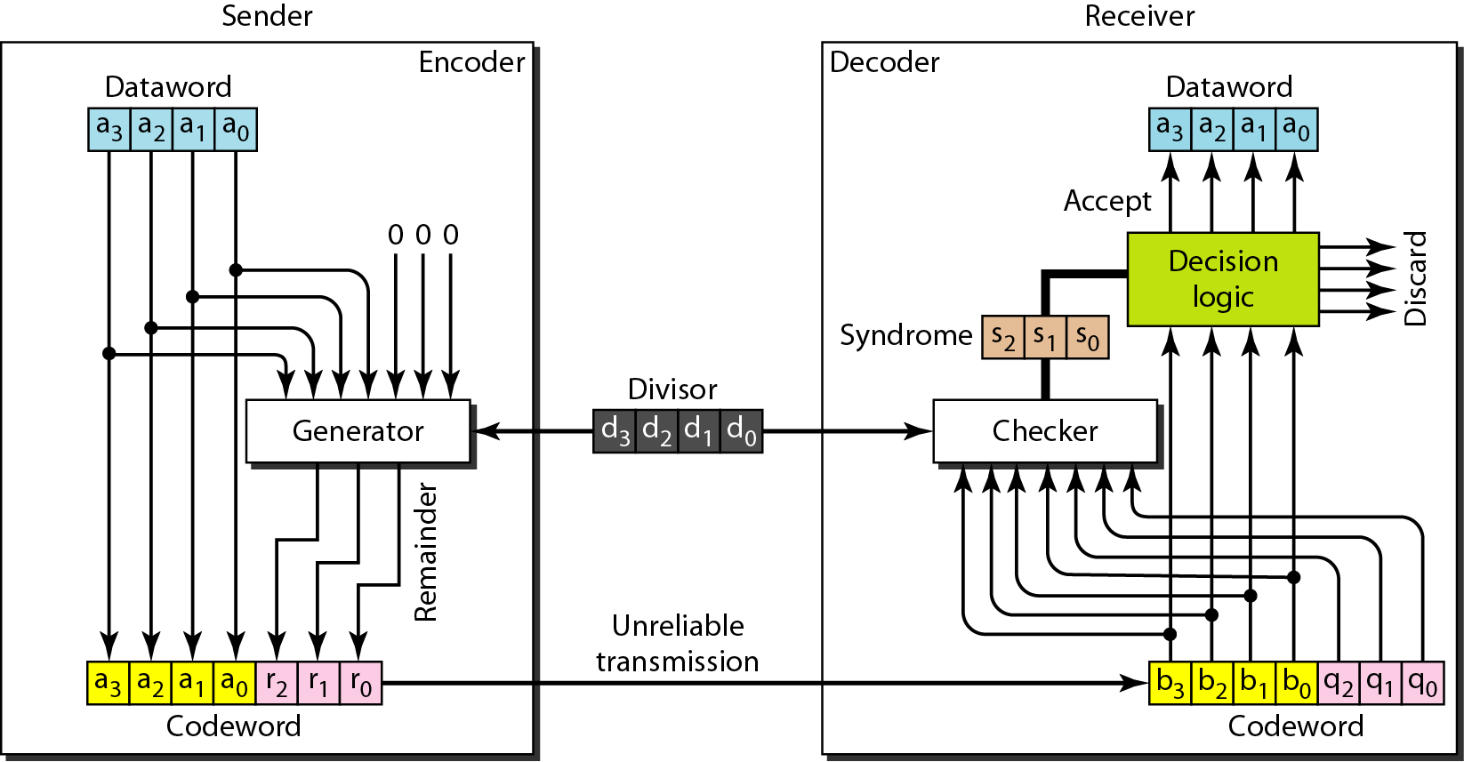
CRC Encoder and Decoder
In the encoder, the dataword has k bits (4 here); the codeword has n bits (7 here).
The size of the dataword is augmented by adding n - k
0s to the right-hand side of
the word.
The n-bit result is fed into the generator.
The divisor in a cyclic code is normally called the generator polynomial.
The generator uses a divisor of size = n - k + 1 (4 here), predefined and agreed upon.

Slide 23
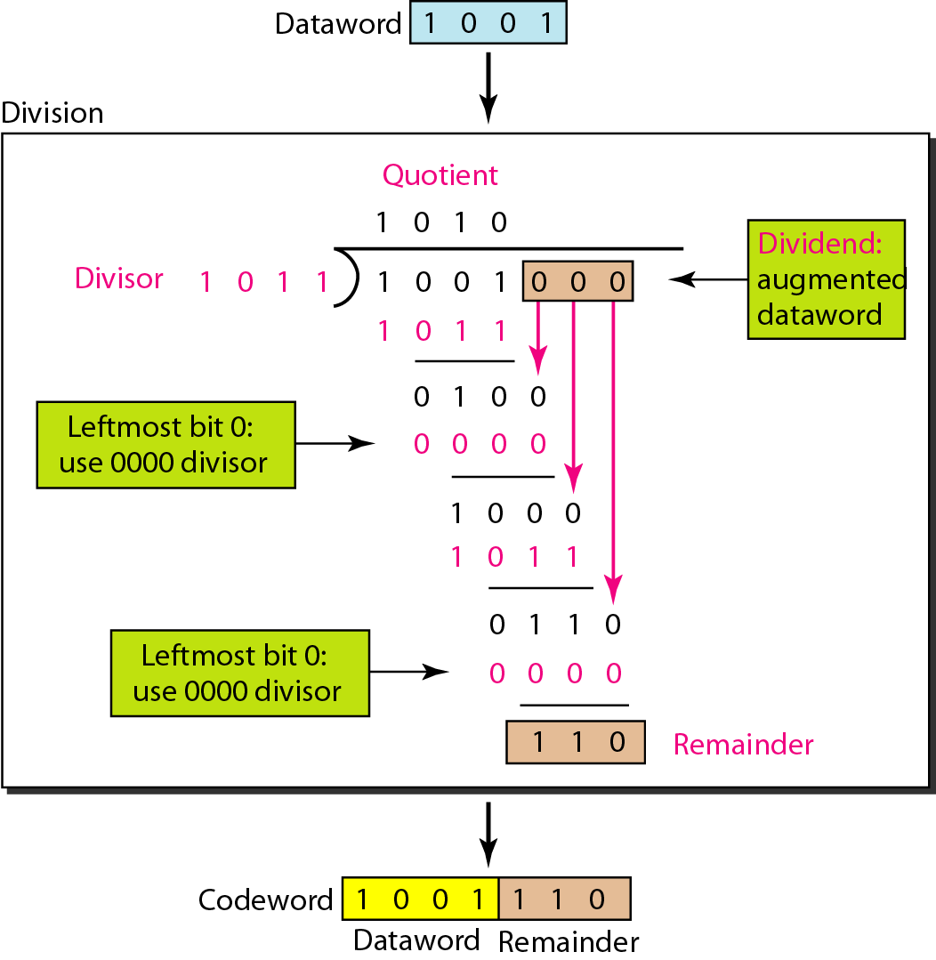
Figure Division in CRC encoder

Slide 24
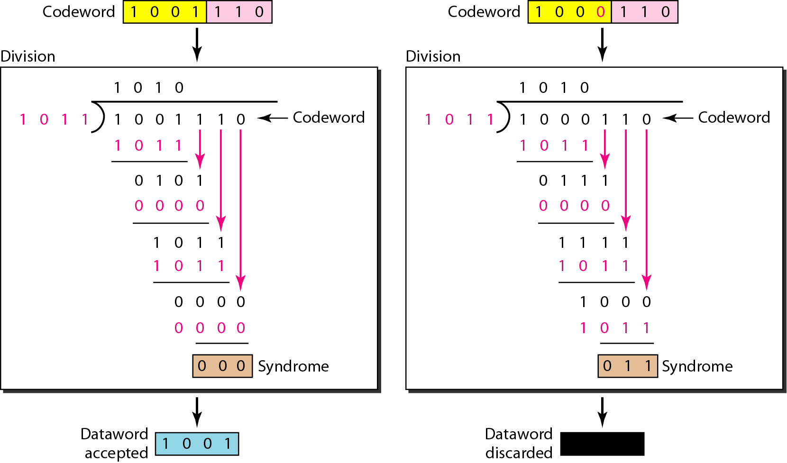
Figure Division in the CRC decoder for two cases

Slide 25
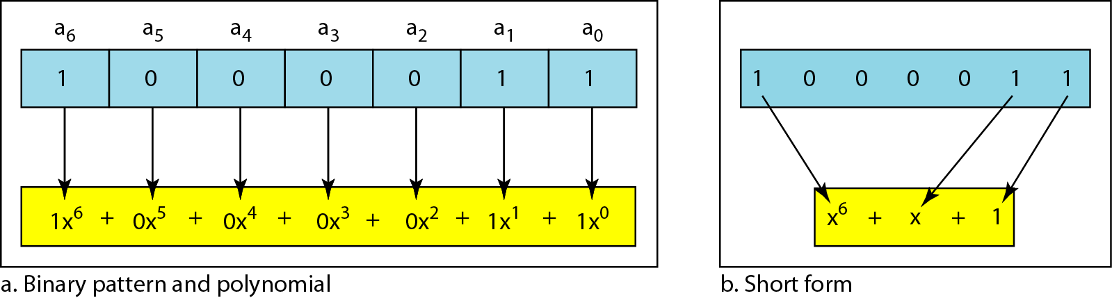
A polynomial to represent a binary word

Slide 26
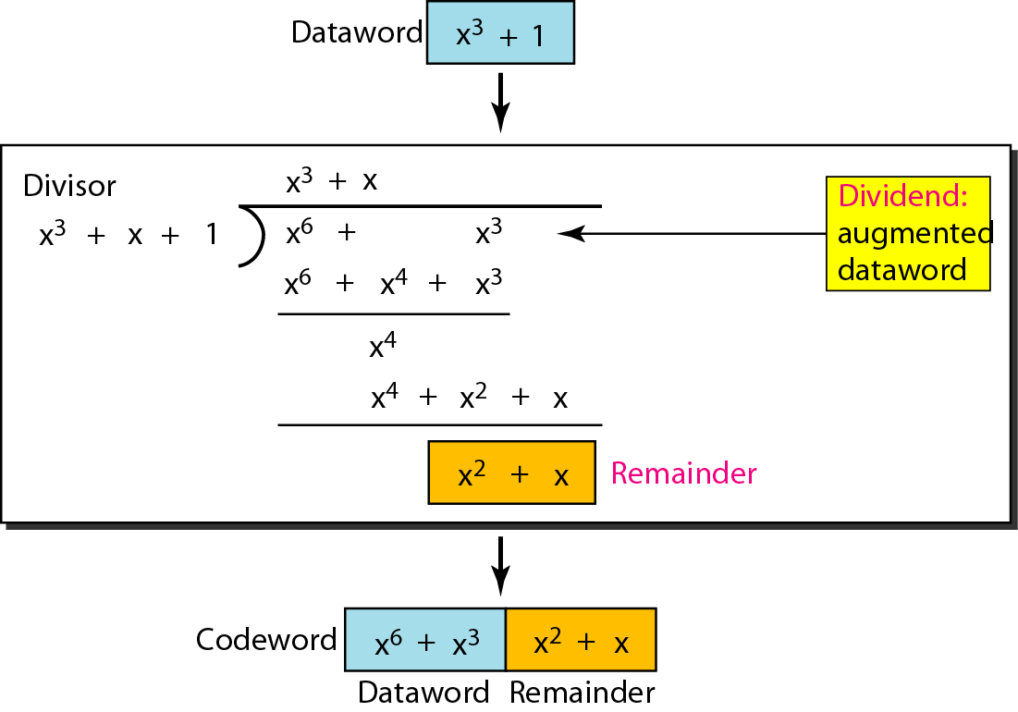
Figure CRC division using polynomials

Slide 27
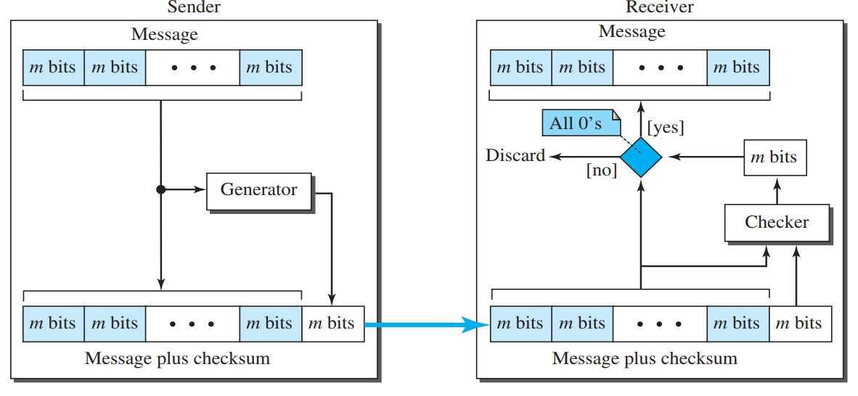
Checksum
Checksum is an error-detecting technique that can be applied to a message of any length. In the Internet, the checksum technique is mostly used at the network and transport layer rather than the data-link layer.
At the source, the message is first divided into m-bit units. The generator then creates an extra m-bit unit called the checksum, which is sent with the message.
At the destination, the checker creates a new checksum from the combination of the message and sent checksum. If the new checksum is all 0s, the message is accepted; otherwise, the message is discarded

Slide 28
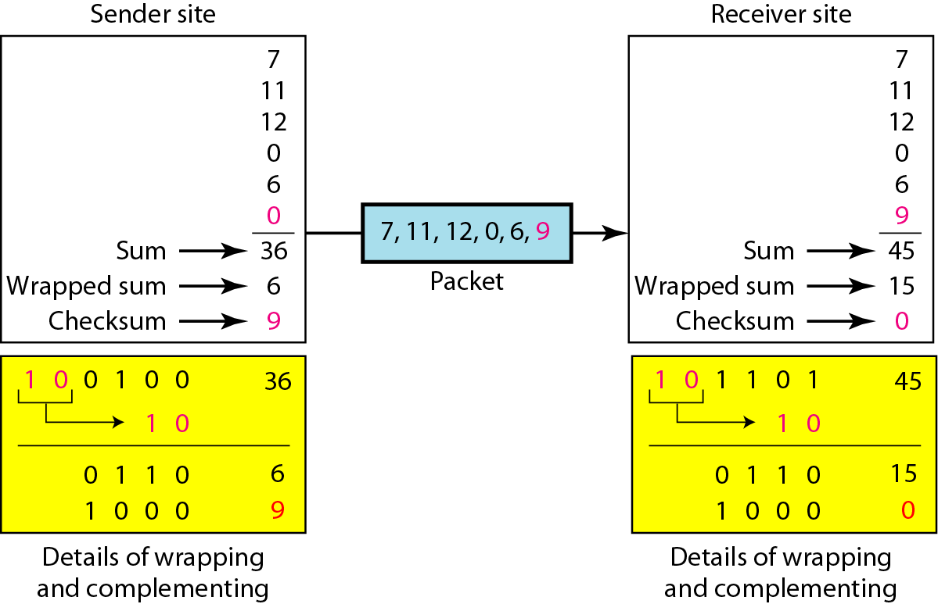
Checksum
Suppose our data is a list of five 4-bit numbers that we want to send to a destination. In addition to sending these numbers, we send the sum of the numbers.
For example, if the set of numbers is (7, 11, 12, 0, 6), we send (7, 11, 12, 0, 6, 9), where 9 is the checksum.
The receiver can add all the numbers received (including the checksum). If the result is 0, it assumes no error; otherwise, there is an error.
1
1
1
0

Slide 29
Data Link Control

Slide 30
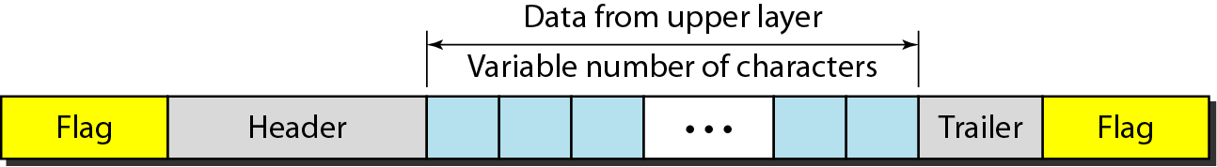
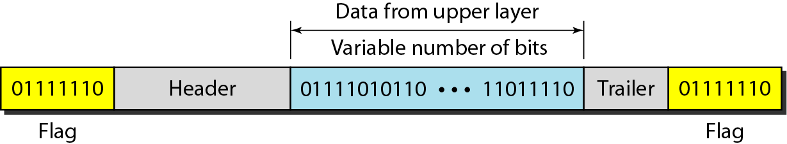
FRAMING
The data link layer needs to pack bits into frames, so that each frame is distinguishable from another.

Slide 31
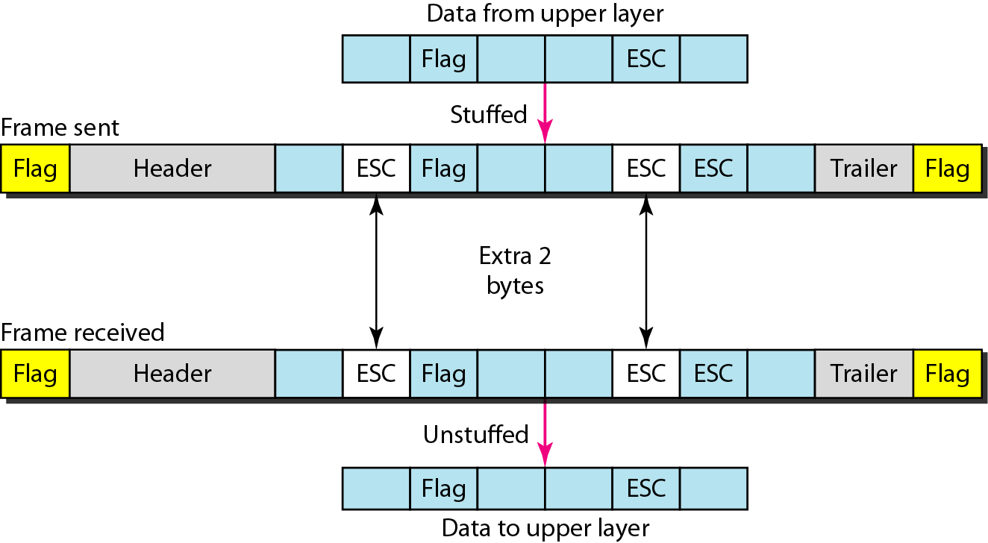
Byte stuffing and unstuffing
Byte stuffing is the process of adding 1 extra byte whenever there is a flag or escape character in the text.

Slide 32
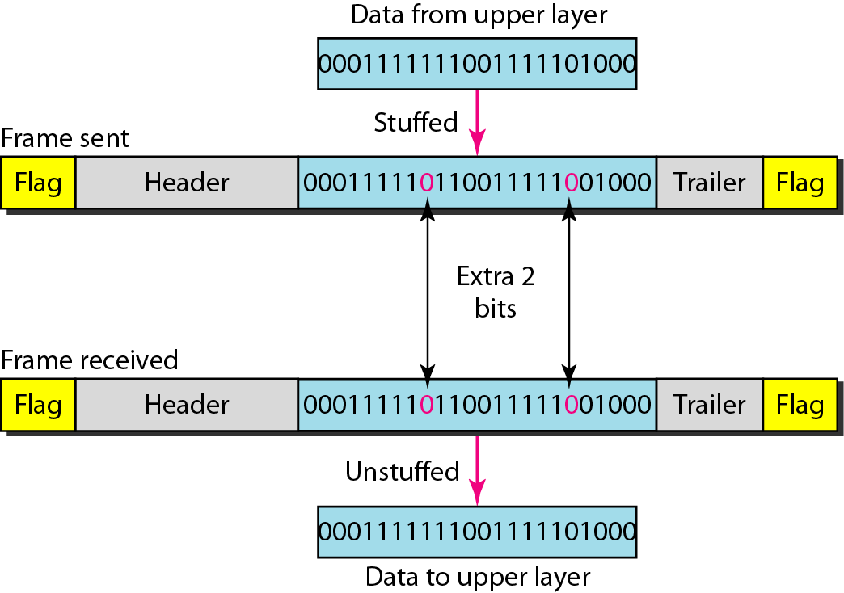
Bit stuffing and unstuffing
Bit stuffing is the process of adding one extra 0 whenever five consecutive 1s follow a 0 in the data, so that the receiver does not mistake
the pattern 0111110 for a flag.

Slide 33
Flow and Error Control
The most important responsibilities of the data link layer are flow control and error control. Collectively, these functions are known as data link control.
Flow Control : Flow control refers to a set of procedures used to restrict the amount of data that the sender can send before waiting for acknowledgment.
Error control: Error control in the data link layer is based on automatic repeat request, which is the retransmission of data.

Slide 34
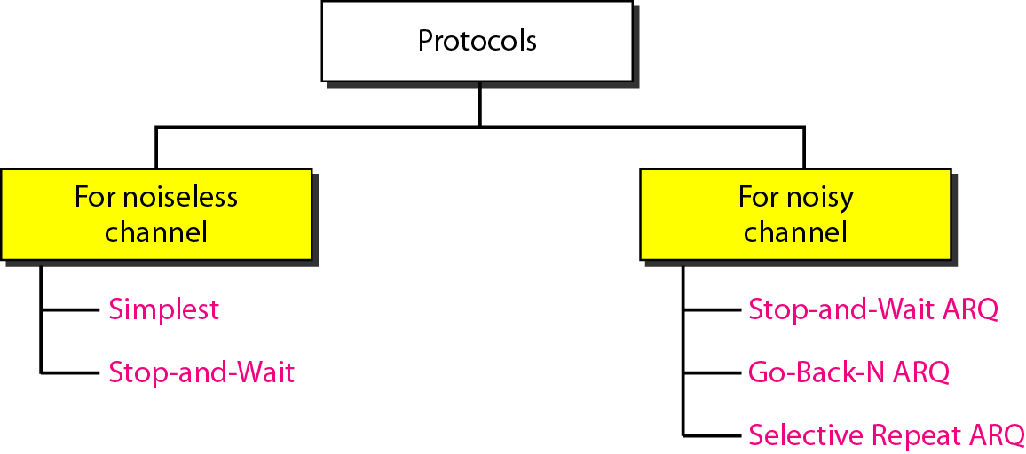

Slide 35
NOISLESS CHANNELS
Let us first assume we have an ideal channel in which no frames are lost, duplicated, or corrupted. We introduce two protocols for this type of channel.
Simplest Protocol
Stop-and-Wait Protocol

Slide 36
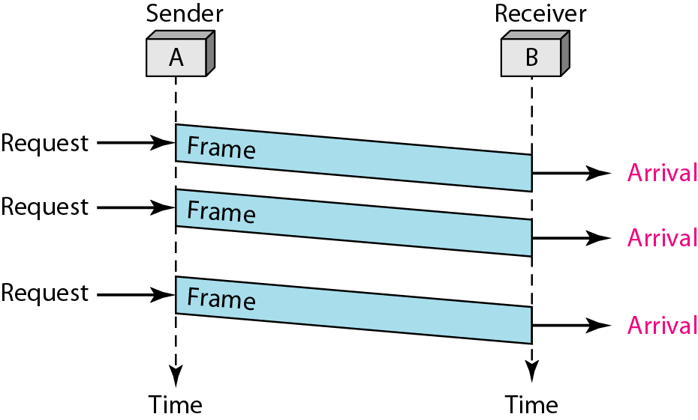
Simplest Protocol
Figure shows an example of communication using this protocol. It is very simple.
The sender sends a sequence of frames without even thinking about the receiver.
To send three frames, three events occur at the sender site and three events at the receiver site.
Note that the data frames are shown by tilted boxes; the height of the box defines the transmission time difference between
the first bit and the last bit in the frame.

Slide 37
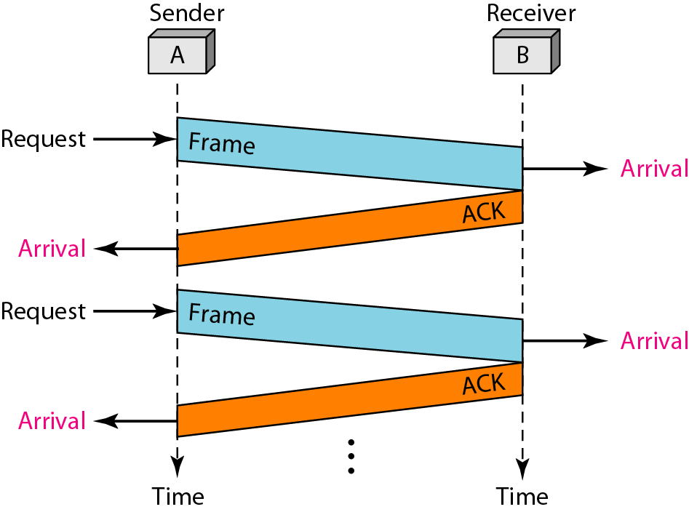
Stop-and-Wait Protocol
Figure shows an example of communication using this protocol. It is still very simple.
The sender sends one frame and waits for feedback from the receiver.
When the ACK arrives, the sender sends the next frame.
Note that sending two frames in the protocol involves the sender in four events and the receiver in two events.

Slide 38
NOISY CHANNELS
Although the Stop-and-Wait Protocol gives us an idea of how to add flow control to its predecessor, noiseless channels are nonexistent. We discuss three protocols in this section that use error control.
Stop-and-Wait Automatic Repeat Request
Go-Back-N Automatic Repeat Request
Selective Repeat Automatic Repeat Request

Slide 39
Stop-and-Wait Automatic Repeat Request
Error correction in Stop-and-Wait ARQ is done by keeping a copy of the sent frame and retransmitting of the frame when the timer expires.
In Stop-and-Wait ARQ, we use sequence numbers to number the frames. The sequence numbers are based on modulo-2 arithmetic.
In Stop-and-Wait ARQ, the acknowledgment number always announces in modulo-2 arithmetic the sequence number of the next frame expected.

Slide 40
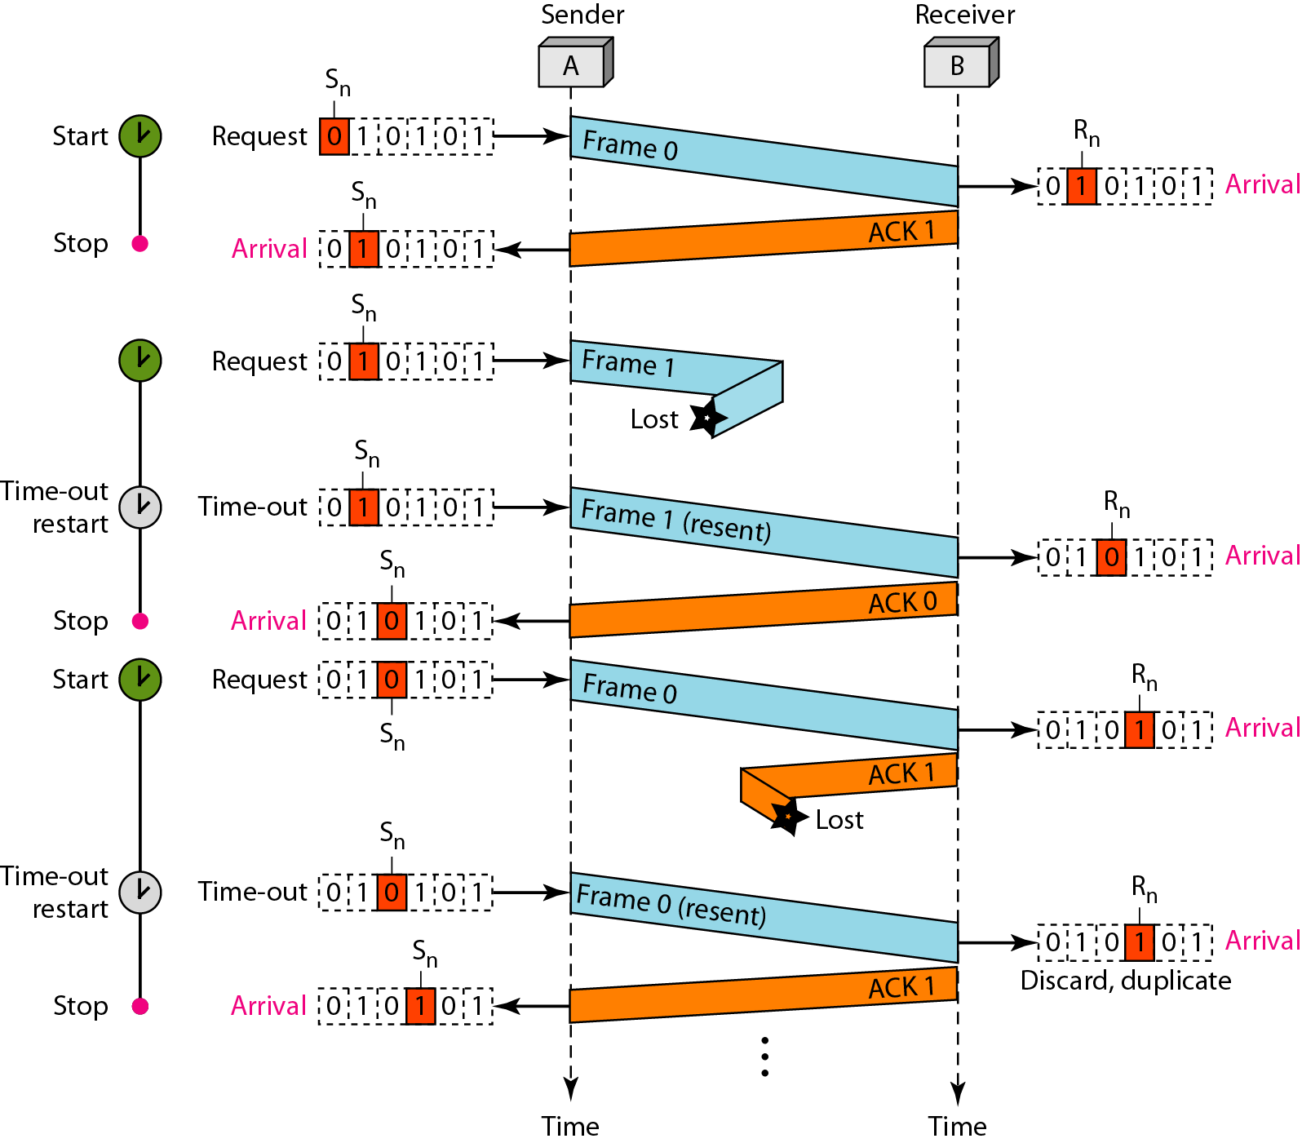
Stop-and-Wait ARQ
Figure shows an example of Stop-and-Wait ARQ.
Frame 0 is sent and acknowledged.
Frame 1 is lost and resent after the time-out. The resent frame 1 is acknowledged and the timer stops.
Frame 0 is sent and acknowledged, but the acknowledgment is lost.
The sender has no idea if the frame or the acknowledgment is lost, so after the time-out, it resends frame 0, which is acknowledged.

Slide 41
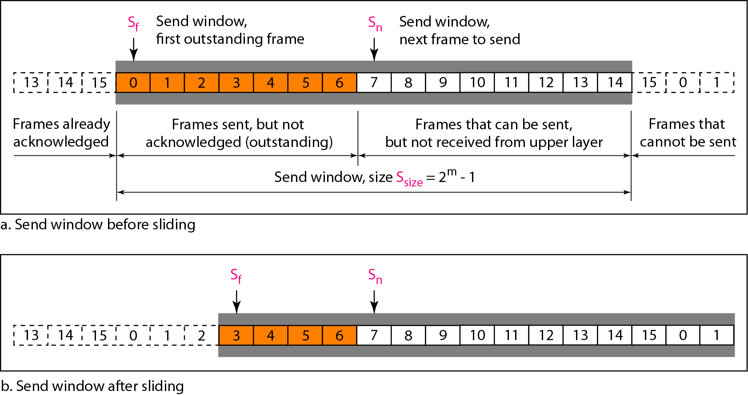
Go-Back-N ARQ
In the Go-Back-N Protocol, the sequence numbers are modulo 2^{m}, where m is the size of the sequence number field in bits.
The send window is an abstract concept defining an imaginary box of size 2^{m} − 1 with three variables: Sf, Sn, and S_{size}.
The receive window is an abstract concept defining an imaginary box of size 1 with one single variable R_{n}.

Slide 42
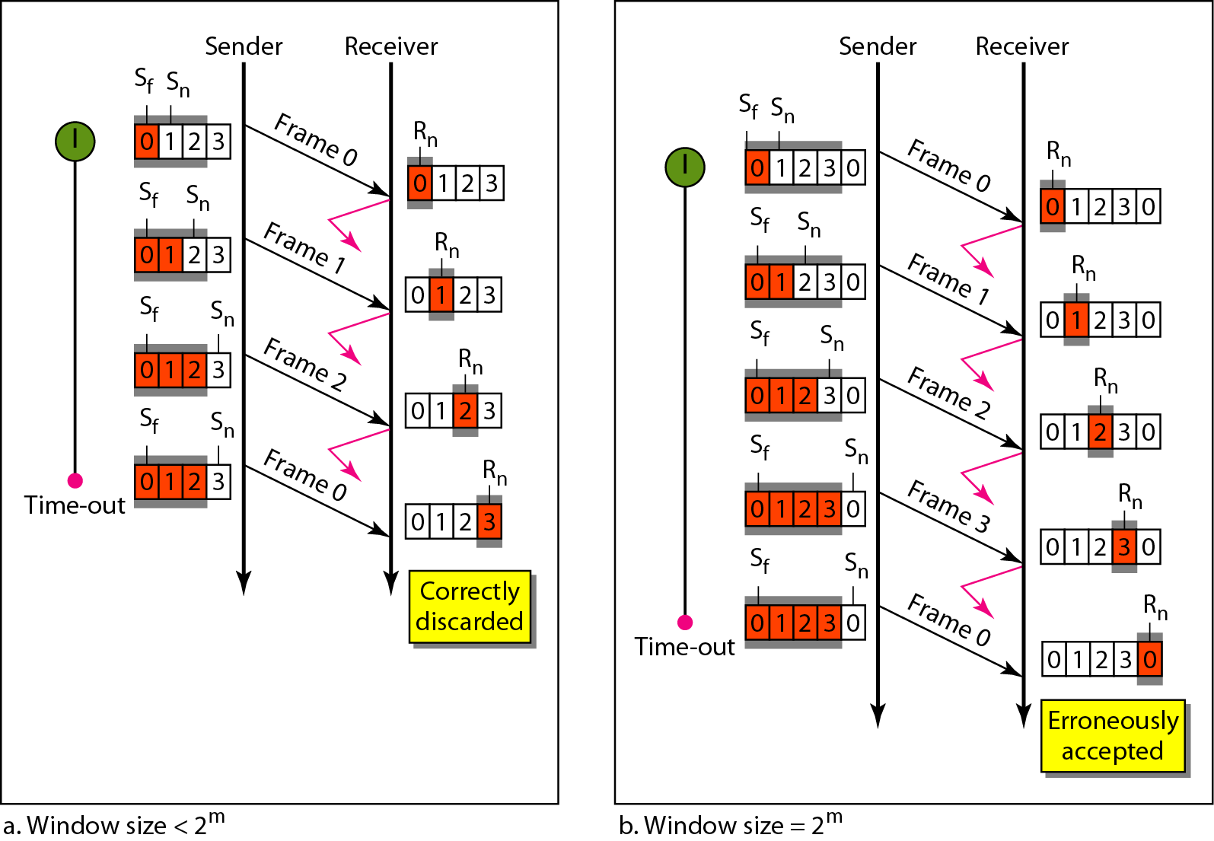
Window size for Go-Back-N ARQ
In Go-Back-N ARQ, the size of the send window must be less than 2^{m} the size of the receiver window is always 1.

Slide 43
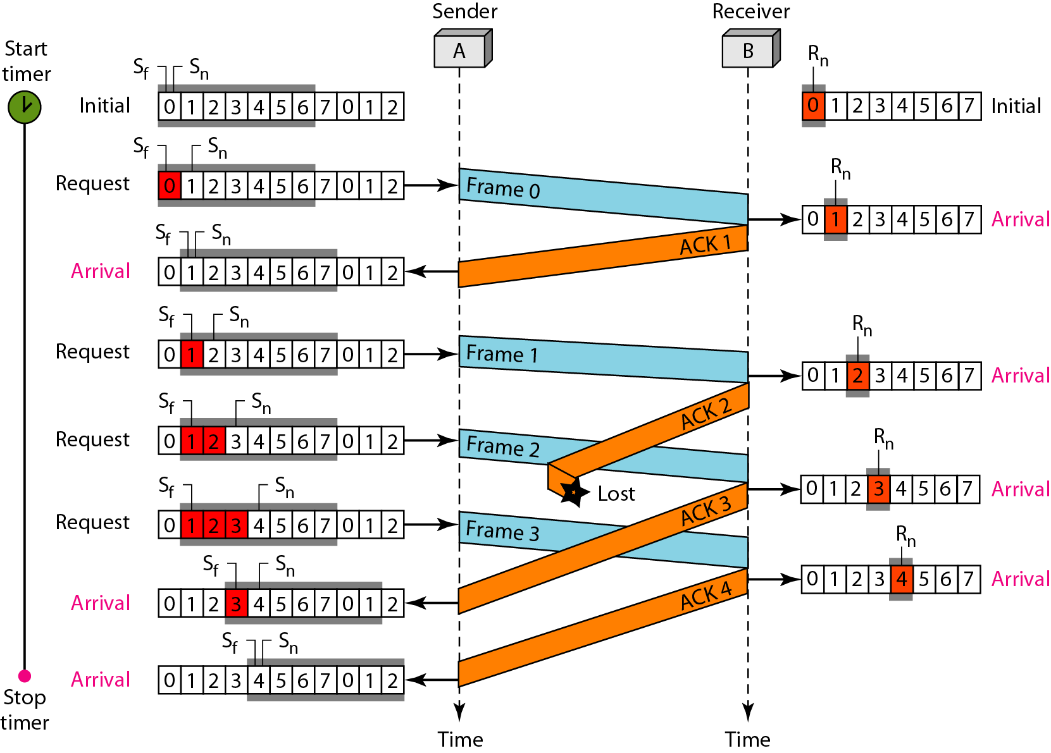
Flow diagram
Figure shows an example of Go-Back-N. After initialization, there are seven sender events.
No data frames are lost, but some ACKs are delayed and one is lost. There is no time-out event here because all outstanding frames are acknowledged before the timer expires.
The example how cumulative acknowledgments can help if acknowledgments are delayed or lost.

Slide 44
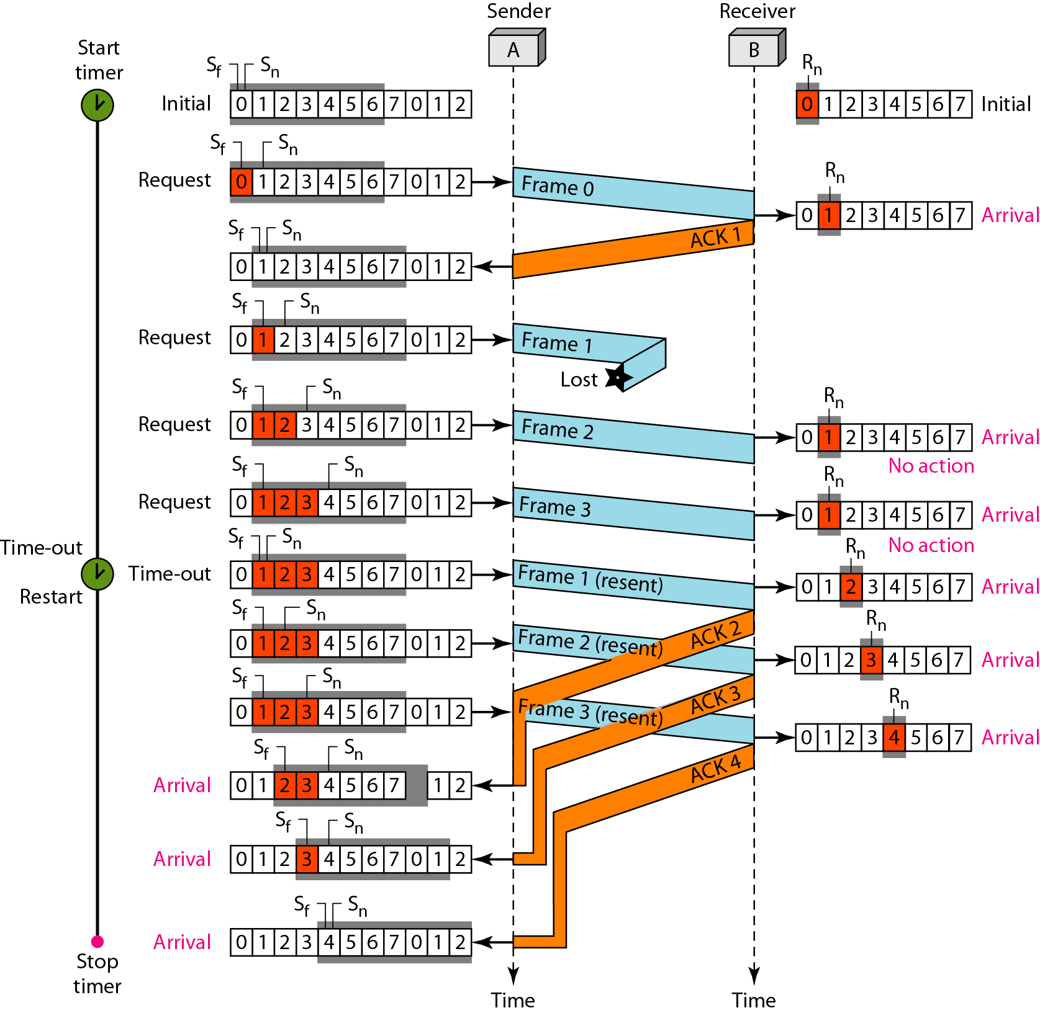
Flow diagram
Figure shows what happens when a frame is lost. Frames 0, 1, 2, and 3 are sent. However, frame 1 is lost. The receiver receives frames 2 and 3, but they are discarded because they are received out of order.
The sender receives no acknowledgment about frames 1, 2, or 3. Its timer finally expires. The sender sends all outstanding frames (1, 2, and 3) because it does not know what is wrong. Note that the resending of frames 1, 2, and 3 is the response to one single event.

Slide 45
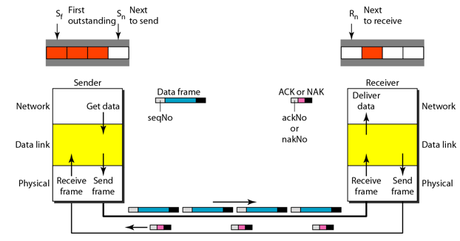
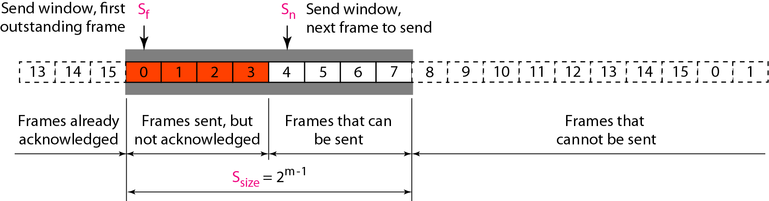
Selective Repeat ARQ
In Selective Repeat ARQ, the size of the sender and receiver window must be at most one-half of 2^{m}

Slide 46
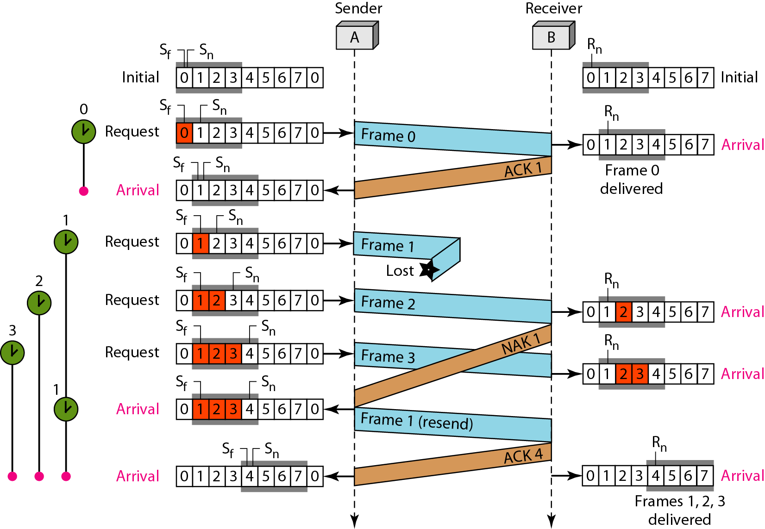
Flow diagram
Example in which frame 1 is lost. Here, each frame sent or resent needs a timer, which means that the timers need to be numbered (0, 1, 2, and 3). The timer for frame 0 starts at the first request, but stops when the ACK for this frame arrives.
The timer for frame 1 starts at the second request, restarts when a NAK arrives, and finally stops when the last ACK arrives. The other two timers start when the corresponding frames are sent and stop at the last arrival event.

Slide 47
Flow diagram
At the receiver site, frame 2 and frame 3 arrive and are stored and marked, but it cannot be delivered because frame 1 is missing. When finally, a copy of frame 1 arrives, frames 1, 2, and 3 be delivered to the network layer.
Another important point is that a NAK is sent after the second arrival, but not after the third. The reason is that the protocol does not want to crowd the network with unnecessary.
The next point is about the ACKs. Notice that only two ACKs are sent here. The first one acknowledges only the first frame; the second one acknowledges three frames. In Selective Repeat, ACKs are sent when data are delivered to the network layer. If the data belonging to n frames are delivered in one shot, only one ACK is sent for all of them.

Slide 48
HDLC
High-level Data Link Control (HDLC) is a bit-oriented protocol for communication over point-to-point and multipoint links. It implements the ARQ mechanisms.
Topics discussed in this section:
Configurations and Transfer Modes
Frames
Control Field

Slide 49
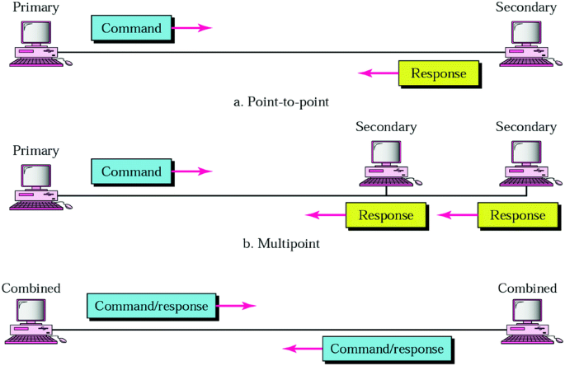
Normal Response Mode(NRM)
In normal response mode(NRM), the station configuration is unbalanced.
One primary station and multiple secondary stations are present.
A primary station can send commands, a secondary station can only respond.
The NRM is used for both point-to-point and multiple-point link.
Figure: Normal Response Mode(NRM)

Slide 50
Asynchronous Balanced Mode (ABM)
In this mode, the configuration is balanced. The link is point-to-point and each station can function as a primary and a secondary.
Figure: Asynchronous Balanced Mode(ABM)

Slide 51
HDLC Frames
HDLC defines three types of frames: information frames (I-frames), supervisory frames (S-frames) and unnumbered frames (U-frames).
I-frames are used to transport user data and control information relating to user data.
S-frames are used only to transport control information.
U-frames are reserved for system management.

Slide 52
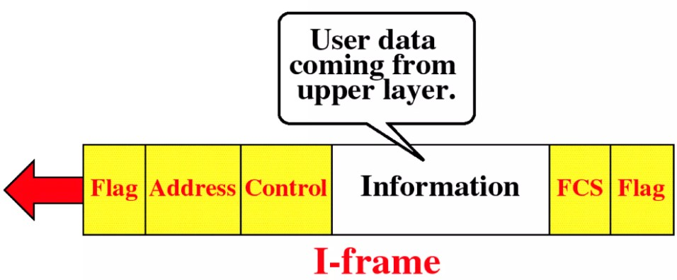
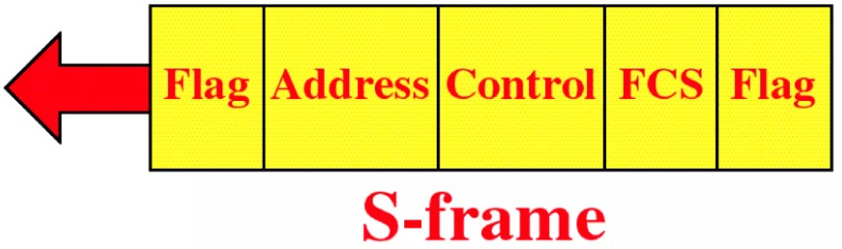
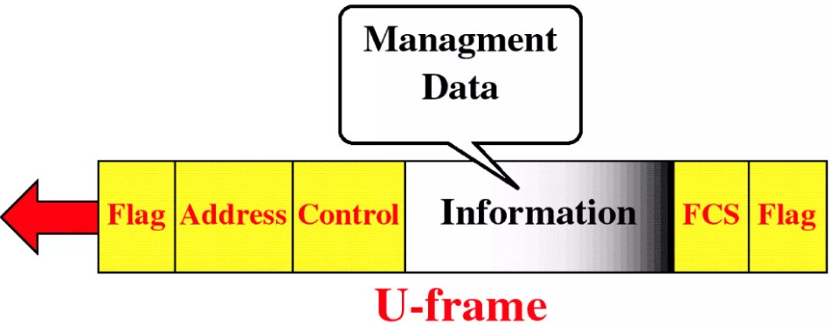
HDLC Frame Format
Each frame in HDLC may contain up to six fields as shown in figure: a beginning flag field, an address field, a control field, an information field, a frame check sequence (FCS) field, and an ending flag field.

Slide 53
Fields
Flag field: The flag field of an HDLC frame is an 8-bit sequence with the bit pattern 01111110 that identifies both the beginning and the end of a frame and serves as a synchronization pattern of the receiver.
Address field: The second field of an HDLC frame contains the address of the secondary station.
Control field: The control field is a 1 or 2-byte segment of the frame used for flow and error control. This field determines the type of frames and defines its functionality
Information field: This field contains the user’s data from the network layer or management information.
FCS field: The frame check sequence (FCS) is the HDLC error detection field. It can contain either a 2- or 4-byte.

Slide 54
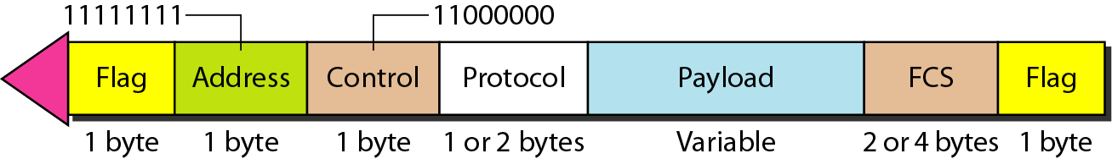
POINT-TO-POINT PROTOCOL
Although HDLC is a general protocol that can be used for both point-to-point and multipoint configurations, one of the most common protocols for point-to-point access is the Point-to-Point Protocol (PPP). PPP is a byte-oriented protocol.

Slide 55
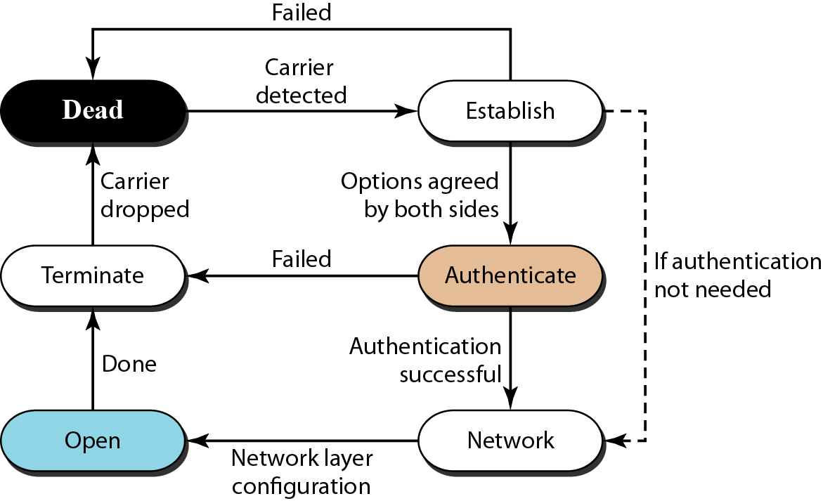
POINT-TO-POINT PROTOCOL
Dead: There is no active carrier (at the physical layer) and the line is quiet.
Establish: When one of the two nodes starts the communication. In this state, options are negotiated between the two parties. If the two parties agree that they need authentication, then the system needs to do authentication (an extra step); otherwise, the parties can simply start communication.
Data transfer takes place in the open state. When a connection reaches this state, the exchange of data packets can be started.
The connection remains in this state until one of the endpoints wants to terminate the connection. In this case, the system goes to the terminate state. The system remains in this state until the carrier (physical-layer signal) is dropped, which moves the system to the dead state again.

Slide 56
Media Access Control (MAC)

Slide 57
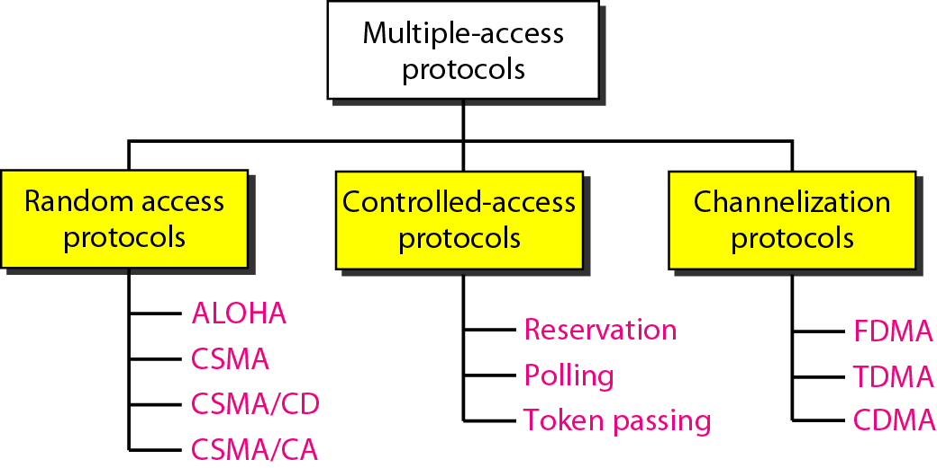
Media Access Control (MAC)
Many nodes or stations are connected and use a common link.
Many protocols have been devised to handle access to a shared link.
All of these protocols belong to a sublayer in the data-link layer called media access control (MAC).

Slide 58
RANDOM ACCESS
In random access or contention methods, no station is superior to another station and none is assigned the control over another. No station permits, or does not permit, another station to send.
At each instance, a station that has data to send uses a procedure defined by the protocol to make a decision on whether or not to send.
ALOHA
Carrier Sense Multiple Access
Carrier Sense Multiple Access with Collision Detection
Carrier Sense Multiple Access with Collision Avoidance

Slide 59
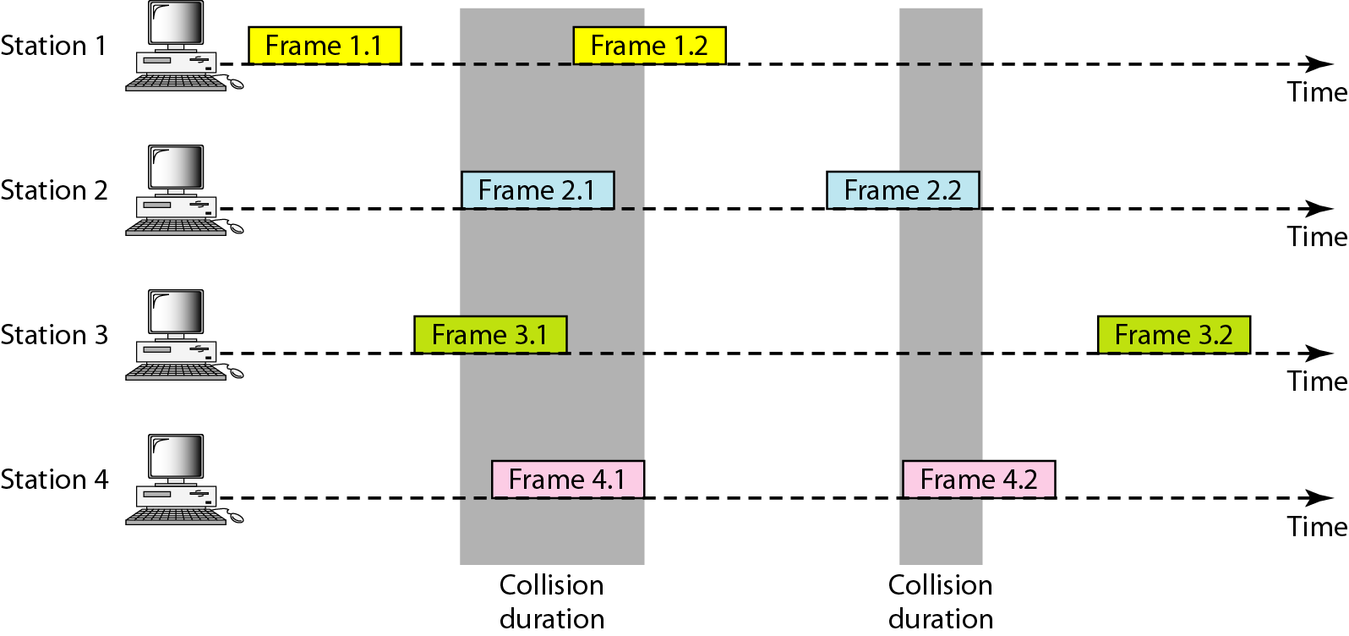
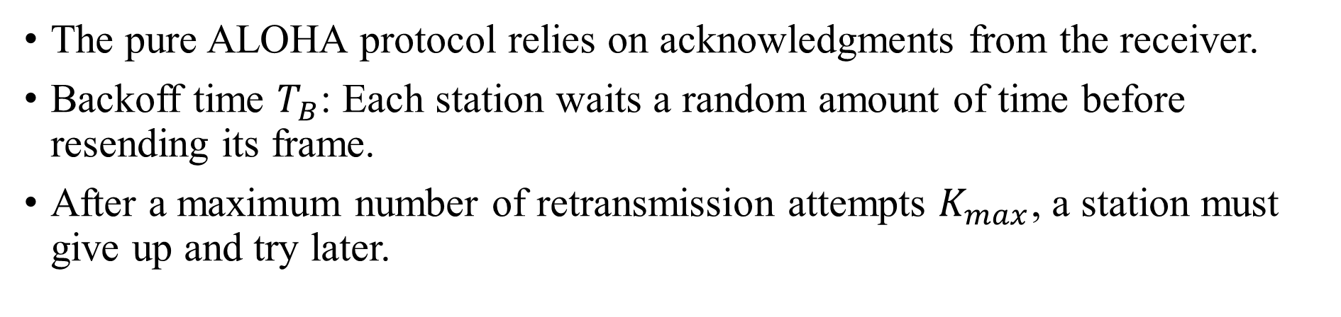
Pure ALOHA
The pure ALOHA protocol relies on acknowledgments from the receiver.
Backoff time $T_{B}$: Each station waits a random amount of time before resending its frame.
After a maximum number of retransmission attempts $K_{max}$, a station must give up and try later.

Slide 60
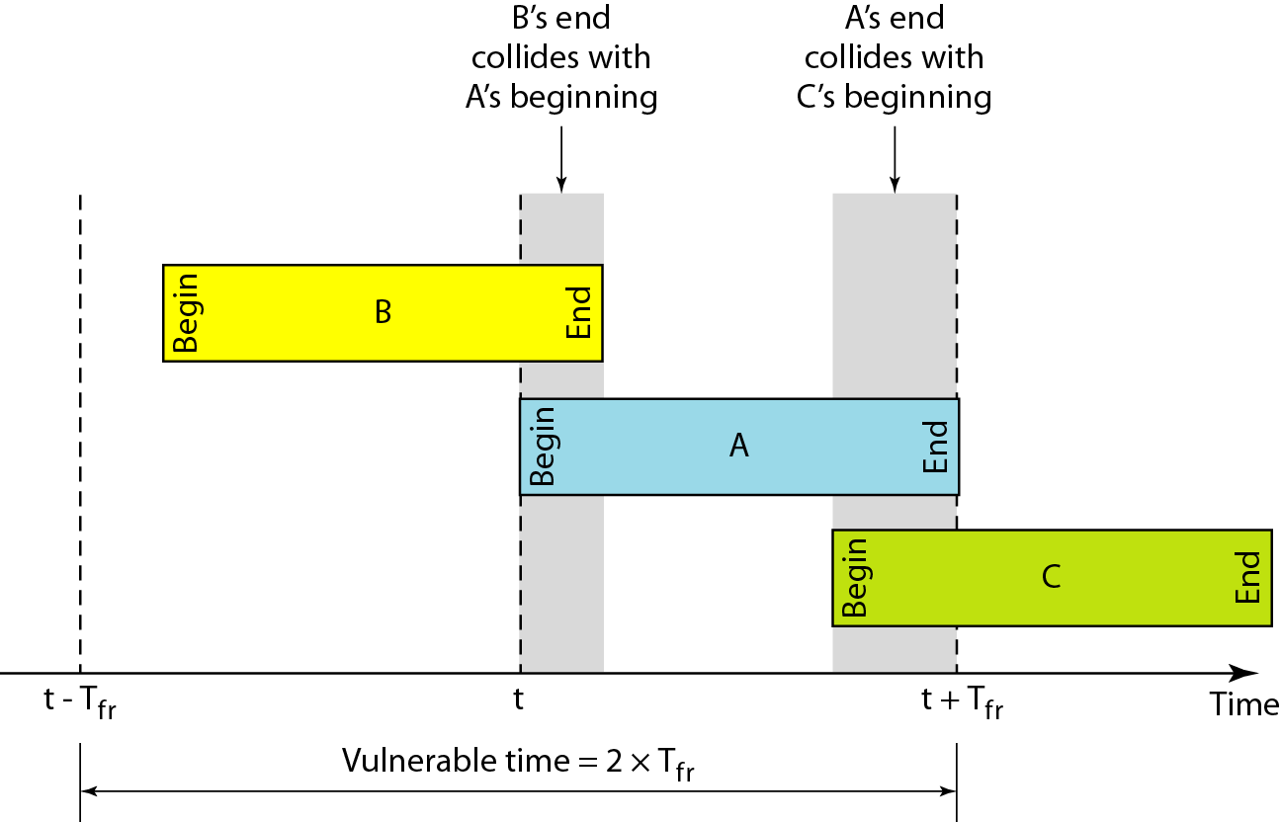
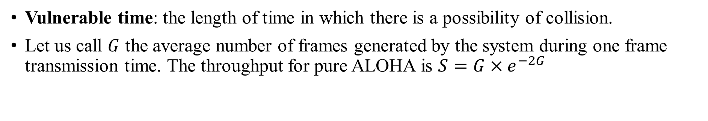
Pure ALOHA
Vulnerable time: the length of time in which there is a possibility of collision.
Let us call $G$ the average number of frames generated by the system during one frame transmission time. The throughput for pure ALOHA is $S=G×e^{−2G}$
Tfr =the average time required to send out a frame

Slide 61
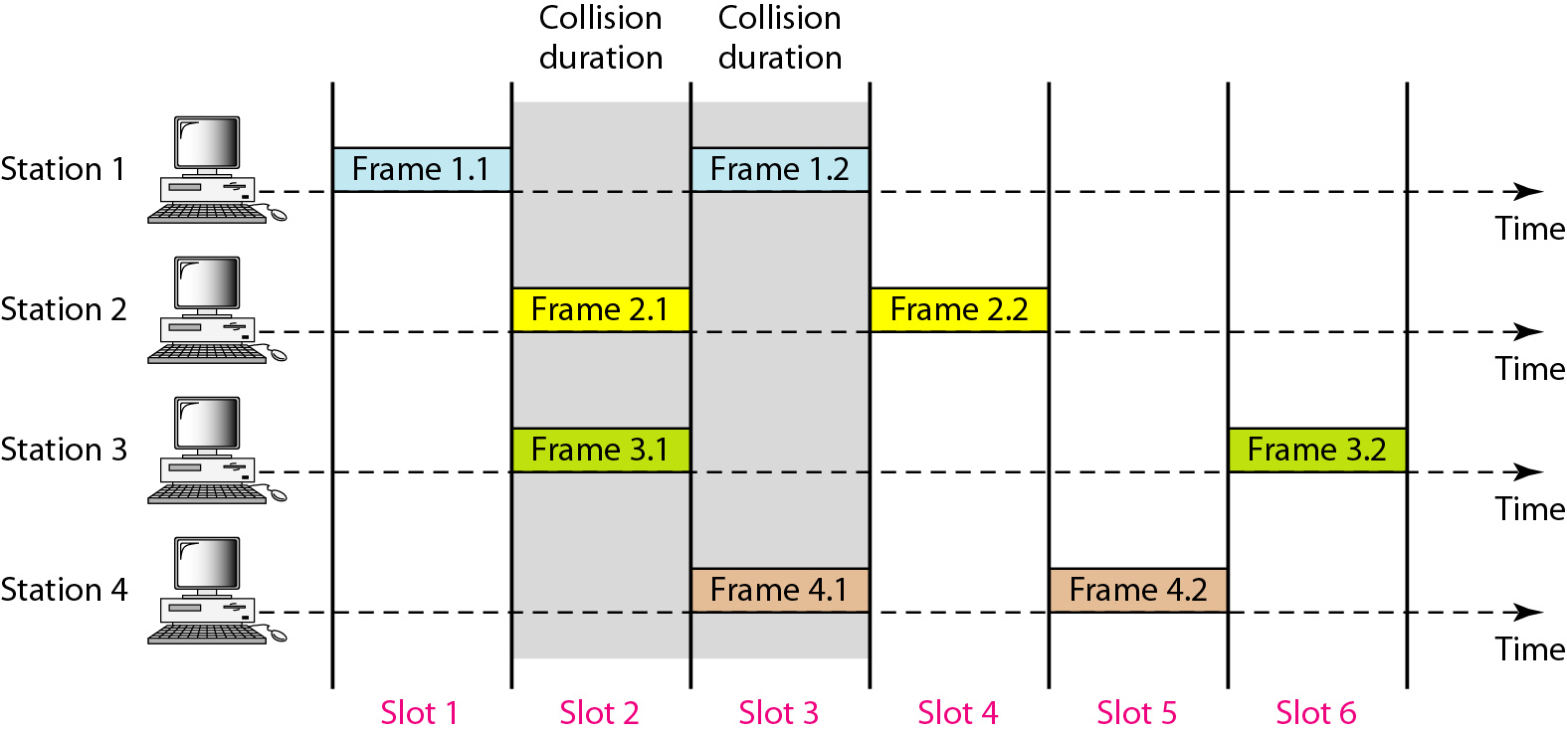
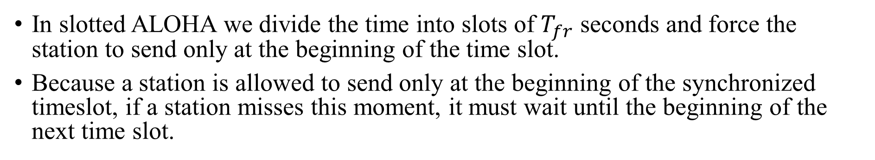
Slotted ALOHA
In slotted ALOHA we divide the time into slots of $T_{fr}$ seconds and force the station to send only at the beginning of the time slot.
Because a station is allowed to send only at the beginning of the synchronized timeslot, if a station misses this moment, it must wait until the beginning of the next time slot.

Slide 62
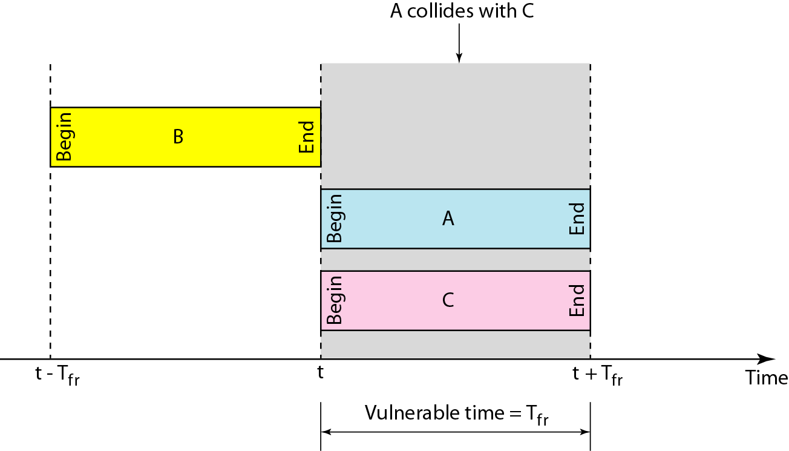
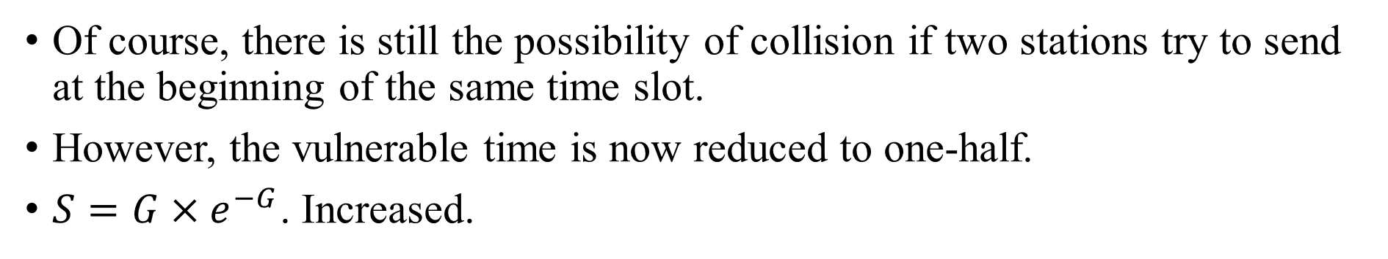
Slotted ALOHA
Of course, there is still the possibility of collision if two stations try to send at the beginning of the same time slot.
However, the vulnerable time is now reduced to one-half.
$S=G×e^{−G}$. Increased.

Slide 63
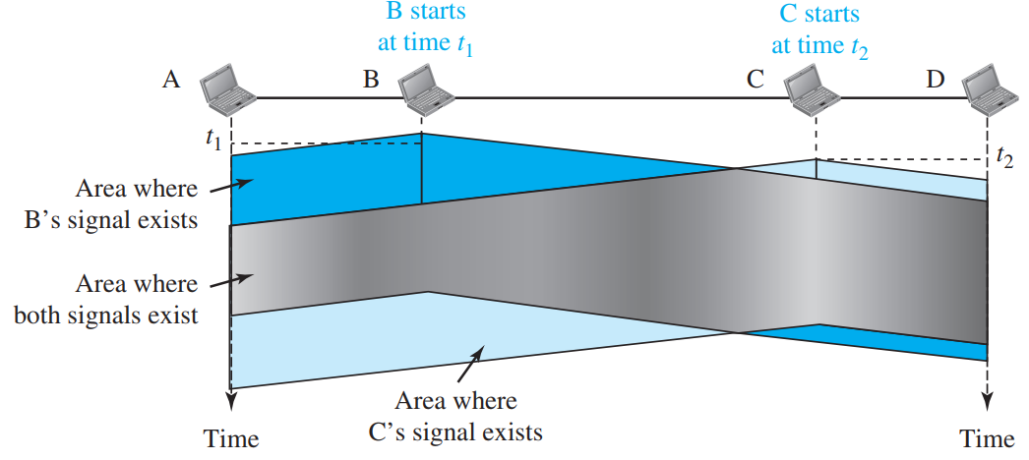

Carrier Sense Multiple Access (CSMA)
It is “sense before transmit” or “listen before talk.”
At time $t_{1}$, station B senses the medium and finds it idle, so it sends a frame.
At time $t_{2}$ ($t_{2}$ > $t_{1}$), station C senses the medium and finds it idle because, at this time, the first bits from station B have not reached station C.
Station C also sends a frame. The two signals collide and both frames are destroyed.

Slide 64

Carrier Sense Multiple Access (CSMA)
The vulnerable time for CSMA is the propagation time $T_{p}$.

Slide 65


Persistence Methods
1-Persistent
The 1-persistent method is simple and straightforward. In this method, after the station finds the line idle, it sends its frame immediately (with probability 1).
Nonpersistent
In the nonpersistent method, a station that has a frame to send senses the line. If the line is idle, it sends immediately. If the line is not idle, it waits a random amount of time and then senses the line again.

Slide 66

Persistence Methods
p-Persistent
The p-persistent approach combines the advantages of the other two strategies. In this method, after the station finds the line idle it follows these steps:
1. With probability p, the station sends its frame.
2. With probability q = 1 - p, the station waits for the beginning of the next time slot and checks the line again.
a. If the line is idle, it goes to step 1.
b. If the line is busy, it acts as though a collision has occurred and uses the backoff procedure.

Slide 67

CSMA/CD
Carrier sense multiple access with collision detection (CSMA/CD) augments the algorithm to handle the collision.
CSMA/CD enables multiple devices to efficiently share a common communication channel by sensing the medium before transmission and detecting collisions during transmission. It aborts transmission and the frame is sent again.

Slide 68

Flow diagram for the CSMA/CD
When a collision occurs, devices immediately stop transmitting, wait for a randomly determined backoff period, and retransmit, thereby reducing repeated collisions and improving network efficiency.

Slide 69


CSMA/CA
Collisions are avoided through the use of CSMA/CA using three strategies: the interframe space, the contention window, and acknowledgments.
When an idle channel is found, the station does not send
immediately. It waits for a period of time called the interframe space or IFS. The IFS can also be used to define the priority of a station or a frame.
The contention window is an amount of time divided into slots. A station that is ready to send chooses a random number of slots as its wait time.

Slide 70
CONTROLLED ACCESS
In controlled access, the stations consult one another to find which station has the right to send. A station cannot send unless it has been authorized by other stations. We discuss three popular controlled-access methods.
Reservation
Polling
Token Passing

Slide 71

Reservation
A station needs to make a reservation before sending data.
A reservation frame precedes the data frames sent in that interval.
If there are N stations in the system, there are exactly N reservation mini slots in the reservation frame. Each mini slot belongs to a station.
When a station needs to send a data frame, it makes a reservation in its own mini slot.
The stations that have made reservations can send their data frames after the reservation frame.

Slide 72

Polling
One device is designated as a primary station and the other devices are secondary stations.
All data exchanges must be made through the primary device even when the ultimate destination is a secondary device.
However, the drawback is if the primary station fails, the system goes down.
Before sending data, the primary creates and transmits a select (SEL) frame
The poll function is used by the primary device to solicit (ask for or try to obtain “data” from someone) transmissions from the secondary devices.
Primary keep soliciting in round robin manner until it receives data from some secondary.

Slide 73

Token Passing
In the token-passing method, the stations in a network are organized in a logical ring.
For each current station, there is a predecessor and a successor. The predecessor is the station which is logically before the successor in the ring.
In this method, a special packet called a token circulates through the ring.
When a station has some data , it waits until it receives the token from its predecessor.

Slide 74
CHANNELIZATION
Channelization is a multiple-access method in which the available bandwidth of a link is shared in time, frequency, or through code, between different stations. In this section, we discuss three channelization protocols.
Frequency-Division Multiple Access (FDMA)
Time-Division Multiple Access (TDMA)
Code-Division Multiple Access (CDMA)

Slide 75

FDMA
In FDMA, the available bandwidth of the common channel is divided into bands that are separated by guard bands.

Slide 76

TDMA
In TDMA, the bandwidth is just one channel that is timeshared between different stations.

Slide 77

Code-Division Multiple Access (CDMA)
In CDMA, one channel carries all transmissions simultaneously.

Slide 78

Code-Division Multiple Access (CDMA)

Slide 79

General rule and examples of creating Walsh tables
The number of sequences in a Walsh table needs to be N = 2^{m}.

Slide 80


Code-Division Multiple Access (CDMA)
$$C_{1}=\left[\begin{matrix}\begin{aligned}1 \\ 1\end{aligned} \\ \begin{aligned}1 \\ 1\end{aligned}\end{matrix}\right],C_{2}=\left[\begin{matrix}\begin{aligned}1 \\ −1\end{aligned} \\ \begin{aligned}1 \\ −1\end{aligned}\end{matrix}\right],C_{3}=\left[\begin{matrix}\begin{aligned}1 \\ 1\end{aligned} \\ \begin{aligned}−1 \\ −1\end{aligned}\end{matrix}\right],C_{4}=\left[\begin{matrix}\begin{aligned}1 \\ −1\end{aligned} \\ \begin{aligned}−1 \\ 1\end{aligned}\end{matrix}\right], Data =\left[\begin{matrix}\begin{aligned}1 \\ −1\end{aligned} \\ \begin{aligned}−3 \\ 1\end{aligned}\end{matrix}\right]$$
To recover $d_{2}$at station 3
$$d_{2}=\frac{1}{N}\left({Data∙C}_{2}\right) \\ =\frac{1}{N}\left({Data}^{T}C_{2}\right) \\ =\frac{1}{4}\left(\left[\begin{matrix}−1 & \begin{matrix}−1 & −3 & 1\end{matrix}\end{matrix}\right]\left[\begin{matrix}\begin{aligned}1 \\ −1\end{aligned} \\ \begin{aligned}1 \\ −1\end{aligned}\end{matrix}\right]\right) \\ = \frac{1}{4}\left(−4\right) \\ =−1 \\ ⇒0 Bit$$

Slide 81

IEEE STANDARDS
In 1985, the Computer Society of the IEEE started a project, called Project 802, to set standards to enable intercommunication among equipment from a variety of manufacturers. Project 802 is a way of specifying functions of the physical layer and the data link layer of major LAN protocols.

Slide 82

802.3 MAC frame
Preamble : The pattern provides only an alert and a timing pulse.
Start frame delimiter (SFD). The SFD warns the station or stations that this is the last chance for synchronization.
Destination address (DA). This field is six bytes (48 bits) and contains the link layer address of the destination station or stations to receive the packet.
Source address (SA). This field is also six bytes and contains the link-layer address of the sender of the packet.
Data. This field carries data encapsulated from the upper-layer protocols. It is a minimum of 46 and a maximum of 1500 bytes.

Slide 83


802.3 MAC frame
If the least significant bit of the first byte in a destination address is 0, the address is unicast; otherwise, it is multicast.

Slide 84


Categories of Standard Ethernet

Slide 85




Categories of Standard Ethernet

Slide 86

IEEE 802.11
IEEE 802.11 defines the basic service set (BSS) as the building blocks of a wireless LAN. A basic service set is made of stationary or mobile wireless stations and an optional central base station, known as the access point (AP).
A BSS without an AP is called an ad hoc network;
a BSS with an AP is called an infrastructure network.

Slide 87

Extended service sets (ESSs)
An extended service set (ESS) is made up of two or more BSSs with APs.
In this case, the BSSs are connected through a distribution system, which is a wired or a wireless network.
The distribution system connects the APs in the BSSs.

Slide 88


BLUETOOTH
Bluetooth is a wireless LAN technology designed to connect devices of different functions such as telephones, notebooks, computers, cameras, printers, coffee makers, and so on.
A Bluetooth LAN is an ad hoc network, which means that the network is formed spontaneously.
Piconets can be combined to form what is called a scatternet. A secondary station in one piconet can be the primary in another piconet.

Slide 89

BLUETOOTH

